Slide 1

South Carolina’s Nonferrous Metals Laws

Slide 2
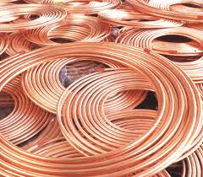
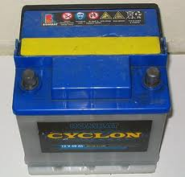
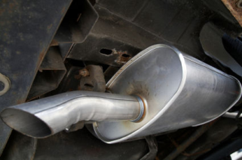
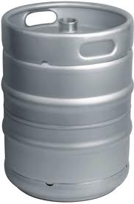
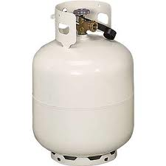
Definition of Nonferrous Metals
(§ 16‑11‑523(A) and § 16‑17‑680(A)(2))
“Nonferrous metals” means metals not containing significant quantities of iron or steel, including, but not limited to:
copper wire, copper clad steel wire, copper pipe, copper bars, copper sheeting,
aluminum other than aluminum cans,
a product that is a mixture of aluminum and copper,
catalytic converters,
lead-acid batteries,
steel propane gas tanks, and
stainless steel beer kegs or containers.

Slide 3
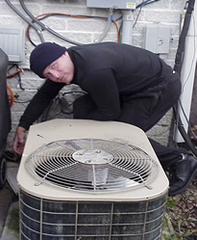

Damaging Property for the Purpose of Obtaining Nonferrous Metals
(§ 16‑11‑523)

Slide 4
Damaging Property for the Purpose of Obtaining Nonferrous Metals (§ 16‑11‑523(B))
It is illegal to intentionally damage property for the purpose of
obtaining nonferrous metals.

Slide 5
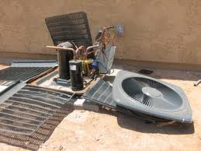

Damaging Property for the Purpose of Obtaining Nonferrous Metals (§ 16‑11‑523(C))
If damage to the property is less than $5,000 = (Misdemeanor) Fined in the discretion of the court, or imprisoned not more than 3 years, or both
If damage to the property is $5,000 or more =
(Felony) Fined in the discretion of the court, or imprisoned not more than 10 years, or both

Slide 6
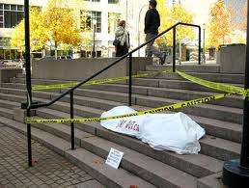
Damaging Property for the Purpose of Obtaining Nonferrous Metals (§ 16‑11‑523(D))
If the violation results in great bodily injury to another person =
(Felony) Imprisoned not more than 15 years
“Great bodily injury” means bodily injury which creates a substantial risk of death or which causes serious, permanent disfigurement, or protracted loss or impairment of the function of any bodily member or organ.
If the violation results in the death of another person = (Felony) Imprisoned not more than 30 years

Slide 7
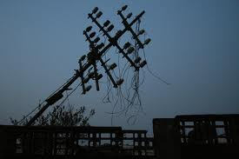
Damaging Property for the Purpose of Obtaining Nonferrous Metals (§ 16‑11‑523(E))
If the violation results in disruption of communication or
electrical service to critical infrastructure or to more than 10
customers of a communication or electrical service =
(Misdemeanor) Fined in the discretion of the court, or
imprisoned not more than 3 years, or both

Slide 8

Damaging Property for the Purpose of Obtaining Nonferrous Metals (§ 16‑11‑523(F))
If the person has been issued a nonferrous metals permit, the
permit must be revoked.

Slide 9
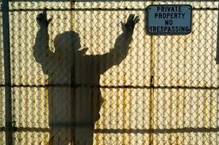
Damaging Property for the Purpose of Obtaining Nonferrous Metals (§ 16‑11‑523(G))
A property owner is not civilly liable to a person who is injured during the theft or attempted theft of nonferrous metals.
A property owner is not civilly liable for a person’s injuries caused by a dangerous condition created as a result of the theft or attempted theft of nonferrous metals when the owner did not know and could not have reasonably known of the dangerous condition.

Slide 10
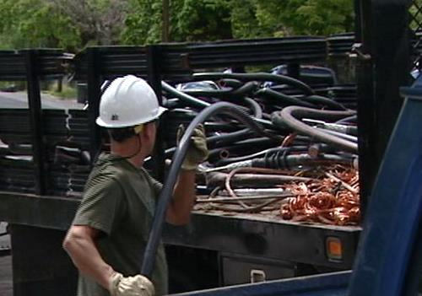
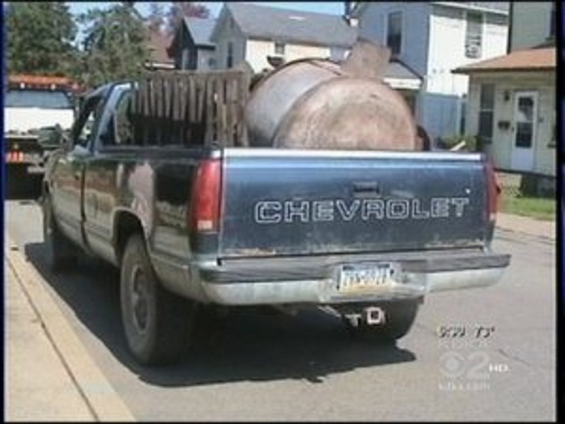
Transporting Nonferrous Metals (§ 16‑17‑680)

Slide 11
Transporting Nonferrous Metals
(§ 16‑17‑680(G)(1))
It is illegal to transport nonferrous metals in a vehicle or have
nonferrous metals in a person’s possession in a vehicle on SC
highways.

Slide 12
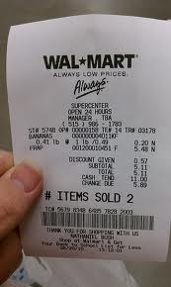

Transporting Nonferrous Metals
(§ 16‑17‑680(G)(2) and (3))
If a law enforcement officer determines that 1 or more of the
following exceptions applies, or the law enforcement officer
determines that the nonferrous metals are not stolen goods,
the law enforcement officer shall not issue a citation:
the person can present a valid permit to transport and sell nonferrous metals; or
the person can present a valid bill of sale for the nonferrous metals.

Slide 13
Transporting Nonferrous Metals
(§ 16‑17‑680(G)(4))
1st Offense = (Misdemeanor) Fined not more than $200 or imprisoned not more than 30 days
2nd Offense = (Misdemeanor) Fined not more than $500, or imprisoned not more than 1 year, or both
3rd or Subsequent Offense = (Misdemeanor) Fined not more than $1,000, or imprisoned not more than 3 years, or both
For an offense to be considered a 3rd or subsequent offense, the offense must have occurred within 10 years of a prior offense.

Slide 14
Transporting Nonferrous Metals
(§ 16‑17‑680(G)(5))
If a person:
knowingly transports stolen nonferrous metals ;
is operating a vehicle used in the ordinary course of business to knowingly transport stolen nonferrous metals;
presents a valid or falsified permit to transport and sell nonferrous metals that the person knows are stolen; or
presents a valid or falsified bill of sale for nonferrous metals that the person knows are stolen
= (Felony) Fined in the discretion of the court, or imprisoned not more than
10 years, or both
If the person has been issued a nonferrous metals permit, the permit must be
revoked.

Slide 15
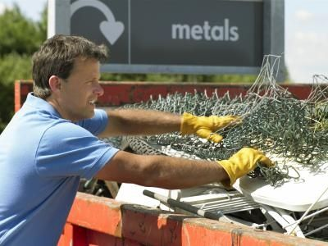

Selling Nonferrous Metals
(§ 16‑17‑680)

Slide 16
Selling Nonferrous Metals
(§ 16‑17‑680(C)(1))
A person or entity who wants to transport or sell nonferrous metals to a secondary metals recycler shall obtain a permit to transport and sell nonferrous metals.
An entity’s employee is not required to obtain a separate permit; however, the employee shall keep a copy of the entity’s permit readily available for inspection.

Slide 17
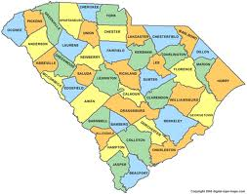
Selling Nonferrous Metals
(§ 16‑17‑680(C)(2))
If the person is a SC resident or an entity located in SC, the
person or entity shall obtain the permit from the sheriff of the
county in which the person resides or has a secondary
residence or in which the entity is located or has a secondary
business.

Slide 18

Selling Nonferrous Metals
(§ 16‑17‑680(C)(2))
The sheriff may issue the permit if the:
person resides or a has a secondary residence or the entity is located or has a secondary business in the sheriff’s county;
person or entity hasn’t been convicted of a nonferrous metals violation; and
person or entity declares on an application that the person is informed of and will comply the permit provisions.

Slide 19
Selling Nonferrous Metals
(§ 16‑17‑680(C)(3))
If the person is not a SC resident or an entity located in SC, the
person or entity shall obtain the permit from any sheriff in any
county in SC.

Slide 20
Selling Nonferrous Metals
(§ 16‑17‑680(C)(3))
The sheriff may issue the permit if the:
person is not a resident of SC or the entity is not located in SC;
person or entity hasn’t been convicted of a nonferrous metals violation; and
person or entity declares on an application that the person is informed of and will comply the permit provisions.

Slide 21
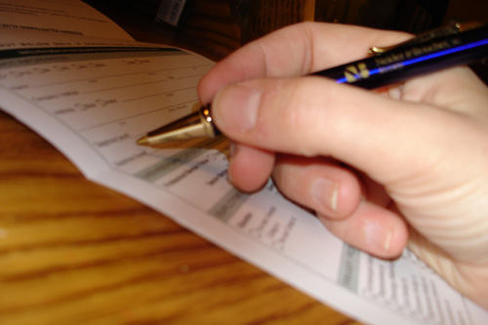


Selling Nonferrous Metals
(§ 16‑17‑680(C)(4))
SLED is responsible for developing the application and permit
in consultation with the State’s sheriffs and representatives of
the secondary metals recyclers’ industry.

Slide 22

Selling Nonferrous Metals
(§ 16‑17‑680(C)(5))
A sheriff may investigate a person or entity’s background prior
to issuing a permit.

Slide 23

Selling Nonferrous Metals
(§ 16‑17‑680(C)(6))
A sheriff may not charge a fee for a permit to transport and sell
nonferrous metals; however a sheriff may charge a $10
replacement fee .

Slide 24

Selling Nonferrous Metals
(§ 16‑17‑680(C)(7))
A sheriff shall keep a record of all permits.

Slide 25
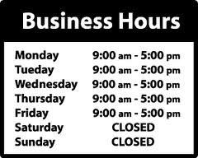
Selling Nonferrous Metals
(§ 16‑17‑680(C)(11))
A sheriff shall issue permits during regular business hours.

Slide 26
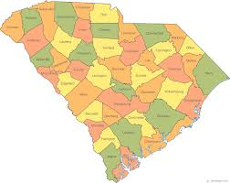
Selling Nonferrous Metals
(§ 16‑17‑680(C)(8))
A permit to transport and sell nonferrous metals is valid
statewide.

Slide 27

Selling Nonferrous Metals
(§ 16‑17‑680(C)(8))
A permit to transport and sell nonferrous metals expires on the
person’s birthday on the 2nd calendar year after the calendar
year in which the permit is issued, or, if the permittee is an
entity, on the date of issuance on the 2nd calendar year after the
calendar year in which the permit is issued.

Slide 28

Selling Nonferrous Metals
(§ 16‑17‑680(C)(9))
A permit may be denied, suspended, or revoked at any
time if a sheriff discovers that the application information
is inaccurate, a person or entity does not comply with the
permit requirements, or a person or entity is convicted of
a nonferrous metals violation.

Slide 29

Selling Nonferrous Metals
(§ 16‑17‑680(C)(10))
It is illegal for a person or entity to obtain a permit for the purpose of transporting and selling stolen nonferrous metals.
Penalty = (Felony) Fined in the discretion of the court, or imprisoned not more than 10 years, or both
The person or entity’s permit must be revoked.

Slide 30
Selling Nonferrous Metals
(§ 16‑17‑680(E)(1)(a))
It is illegal to sell nonferrous metals to a secondary metals
recycler unless:
the secondary metals recycler has a valid permit to purchase nonferrous metals; and
the seller has a valid permit to transport and sell nonferrous metals.

Slide 31
Selling Nonferrous Metals
(§ 16‑17‑680(E)(1)(b))
1st Offense = (Misdemeanor) Fined in the discretion of the court, or imprisoned not more than 1 year, or both
2nd Offense = (Misdemeanor) Fined not less than $500, or imprisoned not more than 3 years, or both
3rd or Subsequent Offense = (Felony) Fined not less than $1,000, or imprisoned not more than 5 years, or both

Slide 32
Selling Nonferrous Metals
(§ 16‑17‑680(E)(2))
It is illegal to purchase or otherwise acquire nonferrous metals in any amount from a seller who does not have a valid permit to transport and sell nonferrous metals with the intent to resell the nonferrous metals to a secondary metals recycler using the purchaser’s valid permit to transport and sell nonferrous metals.
Penalty = (Felony) Fined in the discretion of the court, or imprisoned not more than 10 years, or both.
The person or entity’s permit must be revoked.

Slide 33
Purchasing Nonferrous Metals
(§ 16‑17‑680)

Slide 34
Purchasing Nonferrous Metals
(§ 16‑17‑680(A)(3) and (B)(1))
A secondary metals recycler shall obtain a permit to purchase nonferrous metals.
“Secondary metals recycler” means a person or entity who is engaged, from a fixed site or otherwise, in the business of paying compensation for nonferrous metals that have served their original economic purpose, whether or not the person is engaged in the business of performing the manufacturing process by which nonferrous metals are converted into raw material products consisting of prepared grades and having an existing or potential economic value.
A recycler’s employee is not required to obtain a separate permit; however, the employee shall keep a copy of the recycler’s permit readily available for inspection.

Slide 35
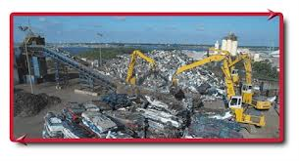
Purchasing Nonferrous Metals
(§ 16‑17‑680 (A)(1) and (B)(2))
If a secondary metals recycler intends to purchase nonferrous metals
at a fixed site, the recycler shall obtain a permit from the sheriff of the
county in which each of the recycler’s fixed locations are located.
“Fixed site” means a site occupied by a secondary metals recycler as the owner of the site or as a lessee of the site under a lease or other rental agreement providing for occupation of the site by a secondary metals recycler for a total duration of not less than 364 days.

Slide 36

Purchasing Nonferrous Metals
(§ 16‑17‑680(B)(2))
The sheriff may issue the permit if the recycler:
has a fixed site or fixed sites located in the sheriff’s county;
has not been convicted of a nonferrous metals violation; and
declares on an application that the recycler is informed of and will comply with the permit provisions.

Slide 37
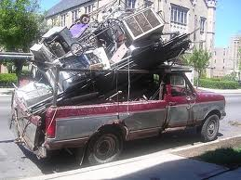
Purchasing Nonferrous Metals
(§ 16‑17‑680(B)(3))
If a secondary metals recycler intends to purchase nonferrous
metals at a location other than a fixed site, the recycler shall
obtain a permit from the sheriff of each county in which the
recycler intends to purchase nonferrous metals.

Slide 38
Purchasing Nonferrous Metals
(§ 16‑17‑680(B)(3))
The sheriff may issue the permit if the recycler:
can sufficiently demonstrate to the sheriff the recycler’s ability to comply with the permit provisions;
has not been convicted of a nonferrous metals violation; and
declares on an application provided by the sheriff that the recycler is informed of and will comply with the permit provisions.

Slide 39
Purchasing Nonferrous Metals
(§ 16‑17‑680(B)(4))
SLED is responsible for developing the application and permit
in consultation with the State’s sheriffs and representatives of
the secondary metals recyclers’industry.

Slide 40
Purchasing Nonferrous Metals
(§ 16‑17‑680(B)(5))
A sheriff may investigate a recycler’s background prior to
issuing a permit.

Slide 41
Purchasing Nonferrous Metals
(§ 16‑17‑680(B)(6))
A sheriff may charge and retain a $200 fee for each permit to
purchase nonferrous metals.

Slide 42
Purchasing Nonferrous Metals
(§ 16‑17‑680(B)(7))
A sheriff shall keep a record of all permits.

Slide 43
Purchasing Nonferrous Metals
(§ 16‑17‑680(B)(11))
A sheriff shall issue permits during regular business hours.

Slide 44
Purchasing Nonferrous Metals
(§ 16‑17‑680(B)(9))
A permit may be denied, suspended, or revoked at any time if a
sheriff discovers that the application information is inaccurate,
a person or entity does not comply with the permit
requirements, or a recycler is convicted of a nonferrous metals
violation.

Slide 45

Purchasing Nonferrous Metals
(§ 16‑17‑680(B)(8))
A permit to purchase nonferrous metals is valid for 24 months.

Slide 46
Purchasing Nonferrous Metals
(§ 16‑17‑680(D)(1))
It is illegal to purchase nonferrous metals in any amount for the
purpose of recycling the nonferrous metals from a seller unless:
the purchaser is a secondary metals recycler with a valid permit to purchase nonferrous metals; and
the seller has a valid permit to transport and sell nonferrous metals.

Slide 47
Purchasing Nonferrous Metals
(§ 16‑17‑680(D)(1))
A recycler may hold a seller’s nonferrous metals while the seller
obtains a permit to transport and sell nonferrous metals.

Slide 48
Purchasing Nonferrous Metals
(§ 16‑17‑680(D)(2))
A secondary metals recycler shall maintain a record containing, at a
minimum:
the date of purchase;
the name and address of the seller;
a photocopy of the seller’s identification;
a photocopy of the seller’s permit to transport and sell nonferrous metals;
if applicable, the license plate number of the seller’s motor vehicle;
the seller’s photograph;
the weight and size or other description of the nonferrous metals purchased;
the amount paid for the nonferrous metals; and
a signed statement from the seller stating that the seller is the rightful owner or is entitled to sell the nonferrous metals.

Slide 49

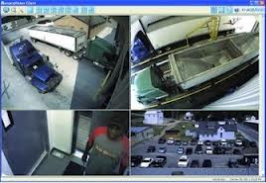

Purchasing Nonferrous Metals
(§ 16‑17‑680(D)(2))
If the recycler has the seller’s photograph on file, the recycler may reference
the photograph on file without making a photograph for each transaction;
however, the recycler shall update the seller’s photograph on an annual basis.
A secondary metals recycler may use a video of the seller in lieu of a
photograph provided the secondary metals recycler maintains the video for at
least 120 days.
A secondary metals recycler may maintain a record in an electronic database
provided that the information can be accessed by law enforcement upon
request.

Slide 50

Purchasing Nonferrous Metals
(§ 16‑17‑680(D)(3))
All nonferrous metals that are purchased by and are in the possession of a recycler and all records must be maintained and kept open for inspection by law enforcement or local and state governmental agencies during regular business hours.
Records must be maintained for 1 year from the date of purchase.

Slide 51

Purchasing Nonferrous Metals
(§ 16‑17‑680(D)(4))
A recycler shall not enter into a cash transaction in payment for the
purchase of copper, catalytic converters, and beer kegs.
Payment must be made by check made payable to the seller.
A recycler shall neither cash the check nor use an ATM or other cash
card system in lieu of a check.

Slide 52
Purchasing Nonferrous Metals
(§ 16‑17‑680(D)(5))
A secondary metals recycler shall prominently display a 20‑inch by
30‑inch sign in the secondary metals recycler’s fixed site that states:
“NO NONFERROUS METALS, INCLUDING COPPER, MAY BE
PURCHASED BY A SECONDARY METALS RECYCLER FROM A
SELLER UNLESS THE SELLER IS A HOLDER OF A RETAIL
LICENSE, AN AUTHORIZED WHOLESALER, A CONTRACTOR
LICENSED PURSUANT TO ARTICLE 1, CHAPTER 11, TITLE 40,
CODE OF LAWS OF SOUTH CAROLINA, 1976, A GAS, ELECTRIC,
COMMUNICATIONS, WATER, PLUMBING, ELECTRICAL, OR
CLIMATE CONDITIONING SERVICE PROVIDER, OR THE SELLER
PRESENTS THE SELLER’S VALID PERMIT TO TRANSPORT AND
SELL NONFERROUS METALS ISSUED PURSUANT TO SECTION
16‑17‑680, CODE OF LAWS OF SOUTH CAROLINA, 1976.”

Slide 53
Purchasing Nonferrous Metals
(§ 16‑17‑680(D)(6))
The penalties for a violation of this section are as follows:
1st Offense = (Misdemeanor) Fined $200-$300 or imprisoned not more than 30 days;
2nd Offense = (Misdemeanor) Fined $400-$500 or imprisoned not more than 1 year, or both; and
3rd or Subsequent Offense = (Misdemeanor) Fined not more than $1,000 or imprisoned not more than 3 years, or both
For an offense to be considered a 3rd or subsequent offense, only those offenses that occurred within 10 years constitute a prior offense.
If the recycler obtained a permit, the permit must be revoked.

Slide 54

Law Enforcement Investigations
(§ 16‑17‑680)

Slide 55
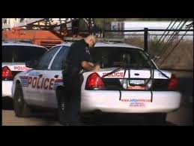
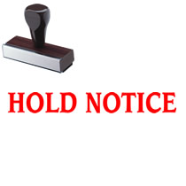
Law Enforcement Investigations
(§ 16‑17‑680(F)(1))
When a law enforcement officer has reasonable cause to believe
that any item of nonferrous metal in the possession of a
secondary metals recycler has been stolen, the law enforcement
officer may issue a hold notice to the recycler.

Slide 56
Law Enforcement Investigations
(§ 16‑17‑680(F)(1))
The hold notice must:
be in writing;
be delivered to the secondary metals recycler;
specifically identify those items of nonferrous metal that are believed to have been stolen and that are subject to the notice; and
inform the secondary metals recycler of the information contained in § 16‑17‑680.

Slide 57
Law Enforcement Investigations
(§ 16‑17‑680(F)(1))
Upon receipt of the notice, the secondary metals recycler must
not process or remove the items of nonferrous metal identified
in the notice, or any portion thereof, from the recycler’s fixed
site for 15 calendar days after receipt of the notice unless
released prior to the 15‑day period by the law enforcement
officer.

Slide 58
Law Enforcement Investigations
(§ 16‑17‑680(F)(2))
No later than the expiration of the 15‑day period, the law
enforcement officer may issue a 2nd hold notice to the recycler,
which is an extended hold notice.

Slide 59
Law Enforcement Investigations
(§ 16‑17‑680(F)(2))
The extended hold notice must:
be in writing;
be delivered to the secondary metals recycler;
specifically identify those items of nonferrous metal that are believed to have been stolen and that are subject to the extended hold notice; and
inform the secondary metals recycler of the information contained in § 16‑17‑680.

Slide 60
Law Enforcement Investigations
(§ 16‑17‑680(F)(2))
Upon receipt of the extended hold notice, the recycler must not
process or remove the items of nonferrous metal identified in
the notice, or any portion thereof, from the recycler’s fixed site
for 30 calendar days after receipt of the extended hold notice
unless released prior to the 30‑day period by the law
enforcement officer.

Slide 61
Law Enforcement Investigations
(§ 16‑17‑680(F)(3))
At the expiration of the hold period or, if extended, at the
expiration of the extended hold period, the hold is
automatically released and the recycler may dispose of the
nonferrous metals unless other disposition has been ordered by
a court.

Slide 62
Law Enforcement Investigations
(§ 16‑17‑680(F)(4))
The penalties for a violation of this section are as follows:
1st Offense = (Misdemeanor) Fined $200-$300 or imprisoned not more than 30 days;
2nd Offense = (Misdemeanor) Fined $400-$500 or imprisoned not more than 1 year, or both; and
3rd or Subsequent Offense = (Misdemeanor) Fined not more than $1,000 or imprisoned not more than 3 years, or both
For an offense to be considered a 3rd or subsequent offense, only those offenses that occurred within a period of 10 years constitute a prior offense.
The recycler’s permit must be revoked.

Slide 63
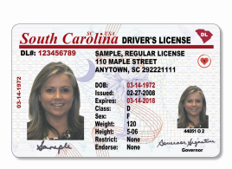
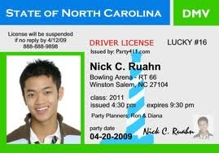
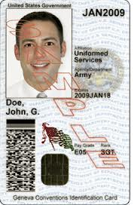
Forms of Identification
(§ 16‑17‑680(H))
For purpose of this section, the only acceptable forms of identification
are:
valid SC driver’s licenses;
valid SC identification cards;
valid picture driver’s licenses from other states; and
valid military identification cards.

Slide 64
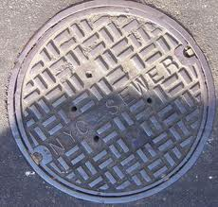
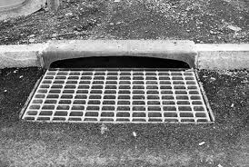
Manhole Covers and Drainage Grates
(§ 16‑17‑680(I))
A recycler must not purchase or otherwise acquire an iron or
steel manhole cover or drainage grate.

Slide 65
Exceptions to the Permit Requirements
(§ 16‑17‑680(J))
The permit requirements do not apply to:
the purchase or sale of aluminum cans;
a transaction between a secondary metals recycler and another
secondary metals recycler;
a governmental entity;
a manufacturing or industrial vendor that generates or sells
regulated metals in the ordinary course of its business;

Slide 66
Exceptions to the Permit Requirements
(§ 16‑17‑680(J))
The permit requirements do not apply to:
a holder of a retail license, an authorized wholesaler, an
automobile demolisher, a licensed contractor, a licensed residential
home builder, a demolition contractor, a provider of gas service,
electric service, communications service, water service, plumbing
service, electrical service, climate conditioning service, core
recycling service, appliance repair service, automotive repair
service, or electronics repair service; or
organizations, corporations, or associations registered with the
State as charitable organizations or any nonprofit corporation.

Slide 67
Exceptions to the Permit Requirements
(§ 16‑17‑680(J))
However, an exempted entity is subject to the provisions that make it
illegal to:
obtain a permit for the purpose of transporting and selling stolen
nonferrous metals; and
knowingly transport stolen nonferrous metals.

Slide 68
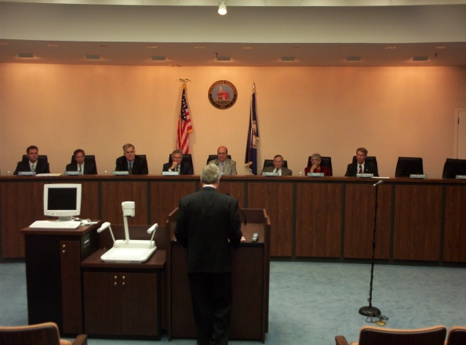
Preemption of Local Ordinances
(§ 16‑17‑680(K))
§ 16‑17‑680 preempts local ordinances and regulations
governing the purchase, sale, or transportation of nonferrous
metals in any amount, except to the extent that such ordinances
pertain to zoning or business license fees.

Slide 69
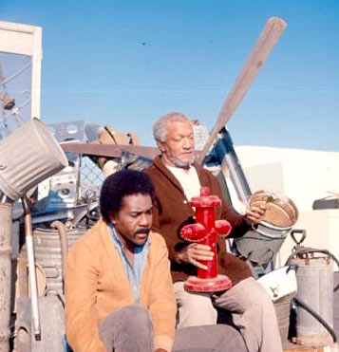
Junk Dealers
(§ 40-27-10 and § 40-27-20)
Any person buying junk that consists of nonferrous metals is
subject to the provisions of § 16‑17‑680.

Slide 70
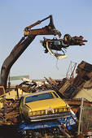
Demolishers
(§ 56-5-5670 and § 56-5-5945)
A demolisher who purchases or otherwise acquires nonferrous
metals is subject to the provisions of § 16‑17‑680.

